Slide 1
The COHRED Group
An introduction
Name of presenter
Name of place, Date

Slide 2
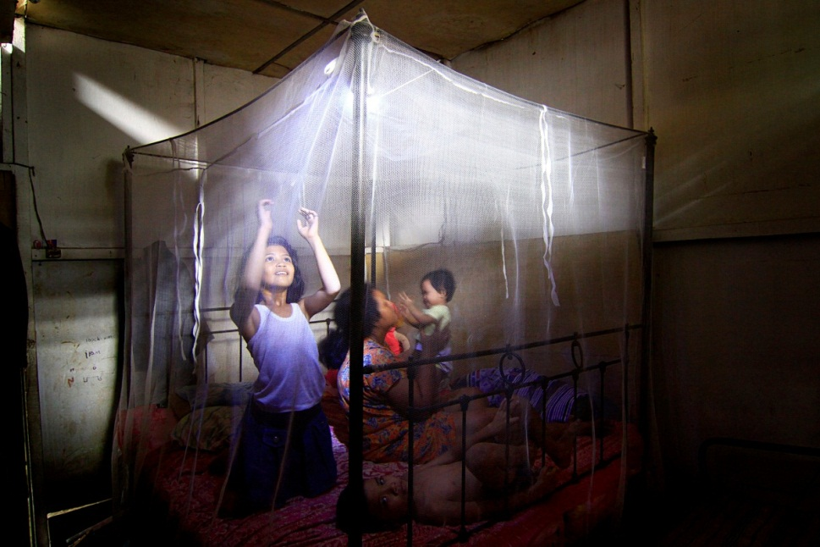
Our mission statement
‘We aim to improve health, equity and development by supporting countries to develop strong research and innovation systems.’
Notes:
In countries, we work with governments and institutions, with organisations and individuals – and in all spheres: the public, for-profit and the mission-driven sectors of society.
We have two primary goals:
To support countries to optimise their research and innovation capacity for the improvement of health, equity and socio-economic progress;
To engage outside agencies whose actions impact on the research and innovation capacity of low and middle income countries – with the aim of making ensuring that their actions are system-supportive.

Slide 3
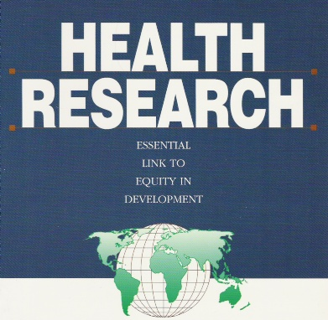
Evolution of the COHRED Group
Commission on Health Research for Development set up
COHRED and Global Forum for Health Research merge
Call for health research
“10/90 Gap” discovered
COHRED established
1980s
1987
1990
1993
2000
2011
1990 Findings:
“10/90 Gap”
Recommendations:
Essential National Health Research
Global financing
Collaboration
Global platform
Notes:
1980s Health and development professionals call for health research to address needs in low- and middle-income countries
1987 Commission on Health Research for Development established to quantify the problem and to propose ways to make health research globally more responsive to the health and development needs of low and middle income countries;
1990 Commission finds 10% of global funding for health research spent on diseases that cause 93% of mortality worldwide – the “10/90 gap”
1993 Council on Health Research for Development (COHRED) set up
2011 COHRED and Global Forum for Health Research merge

Slide 4
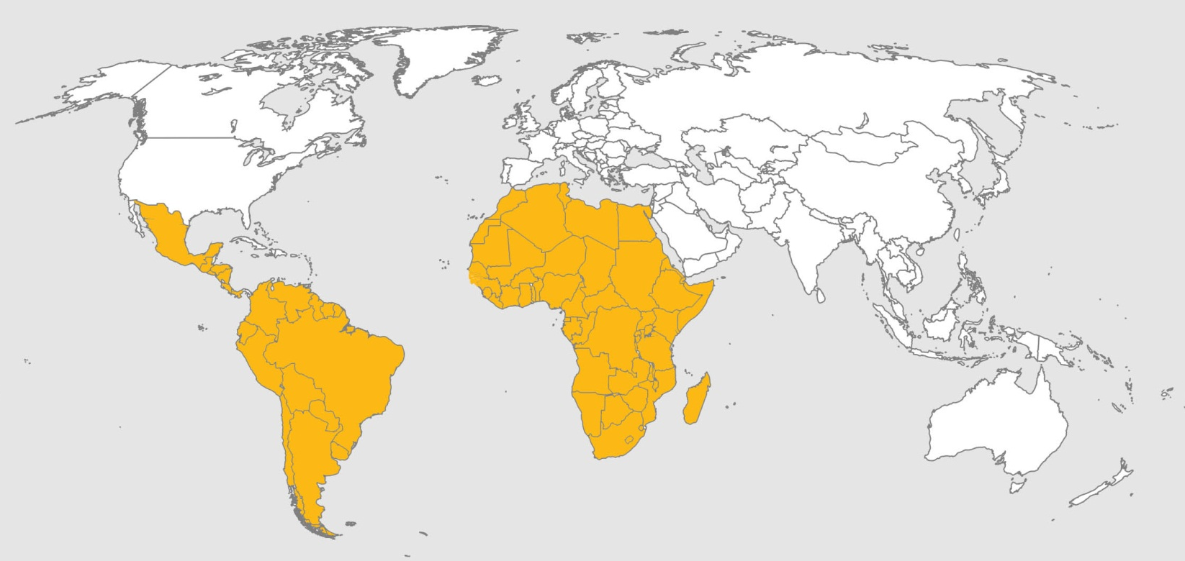
The COHRED Group A Southern alliance with key Northern partners
London, UK
Geneva, Switzerland
Washington, USA
Tashkent, Uzbekistan
Sousse, Tunisia
Beirut, Lebanon
Mexico City, Mexico
Cairo, Egypt
Bogotá, Colombia
Nairobi, Kenya
Belo Horizonte, Brazil
Pretoria, South Africa
Pietermaritzburg, South Africa
We are a non-profit organisation with headquarters in Geneva, Switzerland
Our board members and staff are citizens of the low- and middle-income countries we work with
Notes:
The COHRED Group is a non-profit organisation, based in Geneva, Switzerland.
Most board and staff members are citizens of the low- and middle-income countries COHRED works with. Most also live in those countries.

Slide 5
Supporting research and innovation systems for health, equity and development
Health system
Social and political
development
Health
Health
research
Economic
development
Innovation pathway
Products
Services
Organisational systems
Notes:
COHRED supports countries in their efforts to use research for health and innovation to:
Improve health and reduce health inequities
Improve health sector performance and accountability
Encourage donor alignment and harmonisation
Link research for health with science, technology and innovation
Generate economic and social prosperity.

Slide 6
Supporting research and innovation systems for health, equity and development
Do
Enable
Notes:
‘COHRED – ‘extending conventional wisdom’ – ‘redefining development’
Giving a man/woman a fish
Teaching a man/woman to fish
Creating a system in which everyone can fish (sustainably)
Why address research and innovation?
Research and innovation are key drivers of technical, social and economic development in low- and middle-income countries
The full potential of using these drivers remains to be fully realised
No country has progressed to a higher income level without substantial and sustained investments in research and technology development
BRICS countries demonstrate this: Brazil, India, China, South Africa, among others

Slide 7
Research for Health Africa (R4HA)
To improve governance and management of Research for Health in Africa
Tanzania
Set up a cross-sector national research agenda
0.7% of GDP committed to science and technology
Senegal
Set up a national council for research for health
Mozambique
Defining a national research for health agenda
Policy Development
Research Management
Priority Setting
Ethics Review
Capacity Building
Global Forum
Notes:
Research for Health Africa is a partnership between the COHRED Group and NEPAD.
The aim is to improve the quality and relevance of Research for Health produced in Africa by African countries.
Research for Health Africa works to improve governance and management of research for health in Africa.
The Initial focus is on three countries:
Mozambique
Senegal
Tanzania.
Successes and results
Worked with Tanzania to set-up a cross-sector national research agenda. The country has gone on to commit 0.7% of GDP to science and technology.
In Senegal, R4HA helped to set-up a national council for research for health.
In Mozambique , R4HA is working to define a national research for health agenda.
Contacts:
Sylvia de Haan dehaan@cohred.org
Kathy Douglas douglas@cohred.org

Slide 8
Strengthening R4H systems in West Africa
Collaboration with West African Health Organisation (WAHO) and four countries
WAHO
‘Strengthening research and innovation system development’ now a strategic objective
Liberia, Sierra Leone and Guinea Bissau
Developing national research for health policies and agendas
Liberia
New research unit in the Ministry of Health
Guinea Bissau
First set of research priorities
Policy Development
Research Management
Priority Setting
Ethics Review
Capacity Building
Global Forum
Notes:
Strengthening research for health systems in West Africa is a collaboration between the West African Health Organisation (WAHO) and four West African Countries:
Guinea Bissau,
Liberia,
Mali, and
Sierra Leone.
The project works to:
Strengthen the WAHO Research Unit’s capacities,
Strengthen countries research for health systems,
Build a research for health information management system, and,
Strengthen capacity in health systems research.
Successes and results
The West African Health Organisation (WAHO) has made ‘strengthening research and innovation system development’ one of its strategic objectives.
Liberia, Sierra Leone and Guinea Bissau are currently in the process of developing national research for health policies and agendas.
Liberia has created a Research Unit in its Ministry of Health.
Guinea Bissau has finalised its first research priority-setting effort.
Contact:
Gabriela Montorzi montorzi@cohred.org

Slide 9
Multilateral Association for Studying health inequalities and enhancing North-South and South-South Cooperation (MASCOT)
Analyses national health research systems
Improves use of research results
Identifies and shares best practice
Stimulates collaboration
Dissemination plan and products ready for partners to use
Countries and country experts ready for data gathering
Policy Development
Research Management
Priority Setting
Ethics Review
Capacity Building
Global Forum
Notes:
The Multilateral Association for Studying health inequalities and enhancing North-South and South-South Cooperation (MASCOT) is a collaboration between three Latin American countries, four African countries and two European partners.
The project aims to:
Analyse existing national health research systems and improve the use of research results in the design of policies;
Identify strategies that have been successful and that could lead to the development of new operational policies;
Propose and share efficient research-based recommendations in terms of policies; and,
Stimulate North-South and South-South collaboration.
Dissemination plan and products are ready for partners to use:
Presentation template
Brochure
Flyer
Poster
Newsletter
Webpage
Intranet for partners.
Countries and country experts are ready for data gathering.
A workshop for experts was held March 12-15 2012 in Costa Rica.
Contact:
Francisco Becerra becerra@cohred.org

Slide 10
Capacity building in the Social Determinants of Health Network (SDH-Net)
Creates and strengthens environments that enable and encourage research
Research
Locally relevant
Promotes human rights, equity, social justice, ethics
Can be taken up by policy makers
Policy Development
Research Management
Priority Setting
Ethics Review
Capacity Building
Global Forum
Notes:
Capacity building in the Social Determinants of Health Network (SDH-Net) is a collaboration between:
Three Latin American countries
Brazil, Colombia, Mexico
Three African countries
Kenya, South Africa, Tanzania
Three European partners
Spain, Germany, United Kingdom
The project aims to create and strengthen research environments that enable and encourage research.
The project encourages research that is:
Locally relevant;
Promotes, human rights, equity, social justice and ethics, and
Can be taken up by policy makers.
Contact:
Gabriela Montorzi montorzi@cohred.org

Slide 11
Strengthening research management in Latin America
Through the Red Iberoamericana Ministerial de Aprendizaie e Investigacin en Salud (RIMAIS) network
Train national research for health managers
Boost managerial capacity in research for health
Face-to-face and online training
Policies for research for health, new perspectives, monitoring and evaluation, use of research results
Introductory course, July 2011, Antigua, Guatemala
2012, three on-line courses
Policy Development
Research Management
Priority Setting
Ethics Review
Capacity Building
Global Forum
Notes:
Through Red Iberoamericana Ministerial de Aprendizaie e Investigacin en Salud (RIMAIS the Ibero-American Ministerial Network on Learning and Research for Health), COHRED provides training to national research for health managers in Latin American countries.
Training is face to face and online, and aims to boost managerial capacity in research for health across the region.
Successes and results
In July 2011, an introductory course was held in Antigua, Guatemala.
In 2012, three on-line courses (30 hours each) will be offered.
The focus will be on:
policies for research for health,
new perspectives,
monitoring and evaluation of research for health, and
use of research results.
Contact:
Francisco Becerra becerra@cohred.org

Slide 12
Research Ethics Web
Research Ethics Web
Africa, Latin America
Low- and middle-income countries worldwide
Interactive map
155 research ethics committees, in 34 countries
Medicine regulatory authorities
Policy Development
Research Management
Priority Setting
Ethics Review
Capacity Building
Global Forum
Notes:
The Research Ethics Web provides an interactive map of research ethics committees and medicine regulatory authorities in Africa, Latin America and low- and middle-income countries worldwide.
Successes and results
Information on 155 research ethics committees have been collected in 34 countries and uploaded to the Research Ethics Web.
Contact:
Boitumelo Mokgatla-Moipolai mokgatla@cohred.org

Slide 13
Fair research contracting
Developing model contracts and contracting guidelines
To support low- and middle-income countries institutions and governments in negotiating equitable research for health contracts with northern partners
To be made available on an interactive space and as an action guide
Policy Development
Research Management
Priority Setting
Ethics Review
Capacity Building
Global Forum
Civil Society Organisation (CSO) Engagements
Working with countries to ensure beneficial involvement of CSOs in activities to strengthen research systems
Produced an action guide for CSOs, governments, research institutions and other actors on the best ways of achieving this
Policy Development
Research Management
Priority Setting
Ethics Review
Capacity Building
Global Forum
Notes:
Fair research contracting
COHRED is developing model contracts and contracting guidelines to support low- and middle-income country institutions and governments in negotiating equitable Research for Health contracts with northern partners.
These guidelines will be made available on an interactive space as well as in an action guide.
The Bellagio Meeting – 22 to 26 October 2012
http://www.cohred.org/bellagio-meeting/
Civil Society Organisation (CSO) Engagements
COHRED is working with countries to ensure beneficial involvement of CSOs in activities to strengthen research systems.
For example, in setting research agendas.
An action guide for CSOs, governments, research institutions and other actors has been produced giving guidelines on the best ways of achieving this.

Slide 14
COHRED on the Web
Health Research Web (HRWeb)
www.healthresearchweb.org
Cloud-based information and management platform
Online community of people in pursuit of ‘health for all’
Received honourable mention in report of US Presidential Commission for the Study of Bioethics
Research for Health and Innovation Organiser (RHInnO)
http://rhinno.net
Information and management system for research ethics committees, governments, researchers, medicines regulatory authorities
Quick and reliable ‘near real-time’ data, tables and graphs, which can be used to monitor, evaluate and communicate
Notes:
www.healthresearchweb.org
HRWeb, a cloud-based information and management platform and, as a means to that end, also an online community of people interested in building a high-quality information and management system in a spirit of mutual respect and in pursuit of 'health for all'.
HRWeb, a platform that collects information on studies taking place around the world, as well as information about Institutional Review Boards (IRCs) and research ethics committees, countries’ governance policies and more.
The platform received an honourable mention in the most recent report of the US Presidential Commission for the Study of Bioethics (commissioned by U.S President Barack Obama).
http://rhinno.net
Offers customized cloud-based research and innovation module development to improve management of research for health in low- and middle-income countries.
A cloud-based information and management system for research ethics committees, governments, researchers and medicines regulatory authorities.
The system makes available quick and reliable ‘near real-time’ data, tables and graphs which can be used to monitor, evaluate and communicate.
Contact: David Abreu abreu@cohred.org

Slide 15
Global Forum
Forum meetings are the successor of the Global Forum for Health Research. These meetings are the pre-eminent global platform – for research and innovation in, by and for developing countries and emerging economies – aimed at improving health, reducing inequity and stimulating socio-economic development.
www.cohred.org www.forum2012.org www.globalforumhealth.org
Notes:
Forum 2012 was the first meeting since the Global Forum for Health Research merged with the COHRED Group.
This meeting and its predecessors are the pre-eminent global platform – for research and innovation in, by and for developing countries and emerging economies – aimed at improving health, reducing inequity and stimulating socio-economic development.
Forum 2012: ‘Beyond Aid… Research and Innovation as key drivers for Health, Equity and Development’ was held 24 to 26 April 2012 in Cape Town, South Africa.
This meeting aimed to move beyond traditional discussions of health which focus on unequal allocation of resources, and attracting more donor aid as a way to solve the health problems of low and middle-income countries (LMICs).
Brought together over 400 change makers from across the world and got them to start think about improving health research capacity and stimulating innovation for enterprise development as a better way to help resolve the health problems of LMICs.
This will hopefully create a more productive, equitable development growth path than purely relying on aid.
Forum 2013/2014 - is the pre-eminent global platform for research and innovation in, by and for developing countries and emerging economies – aimed at improving health, reducing inequity and stimulating socio-economic development

Slide 16
Organisational structure
Executive Director COHRED Group
Overall Group management
Administration, communications and development
Resource mobilisation
COHRED Tech
COHRED Connect
COHRED Think
COHRED Web4Dev
Provides technical support, services and products to strengthen research and innovation systems for health
Connecting partners
Local and Global Intelligence
Information and technology solutions for health
Notes:
COHRED Africa/Latin America
Build local portfolio
Build local staff and associates
Decide on status
COHRED or partner
Localisation
Build local resourcing
COHRED Tech
All programmes
Build out portfolio
LMICbasic: NHRS
LMICHigh: Research competitiveness
HIC: Expert adviser and network
Build global associates network
Build TECH network
Build business model
COHRED Core
All administration: legal, financial and contract
HR development
Corporate communication
Business development
Overall group
Each potential unit
COHRED Connect
Advocacy and partnerships for action in research &
Innovation for health, equity and development
To develop, grow and manage the opportunities to which COHRED Connect can
respond.
To develop the finances and partnerships with which to do this.
To deliver the highest quality of products, services or events.
COHRED Think
To develop, grow and manage the opportunities to which COHRED Think can respond.
To develop the finances and partnerships with which to do this.
To deliver the highest quality of products, services or events.
COHRED Web4Dev
To develop, grow and manage the opportunities to which COHRED W4D can
respond.
To develop the finances and partnerships with which to do this.
To deliver the highest quality of products, services or events.

Slide 17
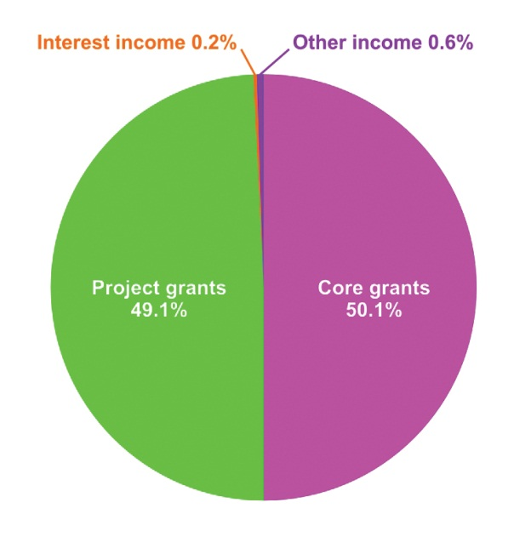
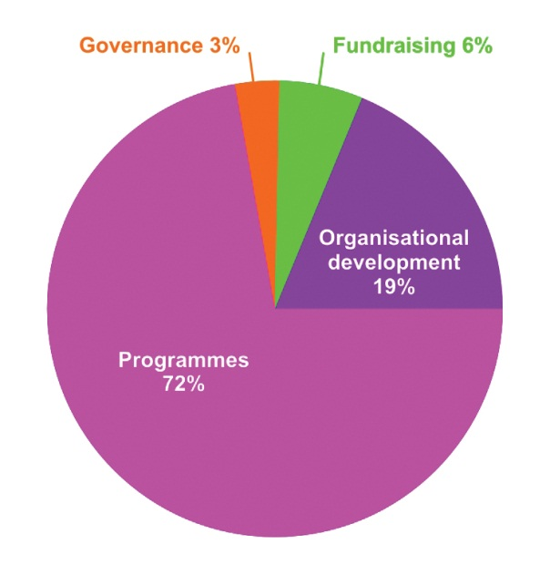
Our finances
Revenue
Expenditure
Core grants
Swiss Agency for Development and Cooperation (SDC) 45.3%
Global Forum for Health Research 36.1%
Irish Aid 16.6%
Others 2.0%
Project grants
Netherlands Directorate-General for International Cooperation (DGIS) 39.9%
Global Forum for Health Research 39.8%
European and Developing Countries Clinical Trials Partnership (EDCTP) 8.9%
West African Health Organisation 4.3%
WHO/TDR 2.5%
Others 6.5%

Slide 18
COHRED Group partners
MASCOT, SDH-NET, EU-LAC, CAAST-NET
> 35 different partners
Notes:
Doris Duke Charitable Foundation
European Commission
Irish Aid
Ministry of Foreign Affairs, Directorate-General for International Cooperation (DGIS), The Netherlands
National Institutes of Health (NIH)
Pfizer
Red Iberoamericana Ministerial de Aprendizaie e Investigacin en Salud (RIMAIS)
The Euroepean and Developing Countries Clinical Trials Partnerships (EDCTP)
The International Development Research Centre (IDRC)
The International Network for the Demographic Evaluation of Populations and Their Health in Developing Countries (INDEPTH)
The New Partnership for Africa’s Development (NEPAD)
The World Bank Group
University of the Western Cape, South Africa
West African Health Organisation (WAHO)
World Health Organization – Regional Office for the Eastern Mediterranean
World Health Organisation – TDR, the Special Programme for Research and Training in Tropical Diseases
World Health Organisation – The Department of Public Health, Innovation, Intellectual Property and Trade (PHI)
The Swiss Agency for Development and Cooperation (SDC)

Slide 19
Contact us
Email: cohred@cohred.org
Find us on:
Twitter: www.twitter.com/cohred
Facebook: www.facebook.com/cohredgroup
YouTube: 'cohredgroup‘
Flickr: http://www.flickr.com/photos/cohred
www.cohred.org

